Slide 1

RoboRebeca: A Framework to Design Verified ROS-based Robotic Programs

Slide 2
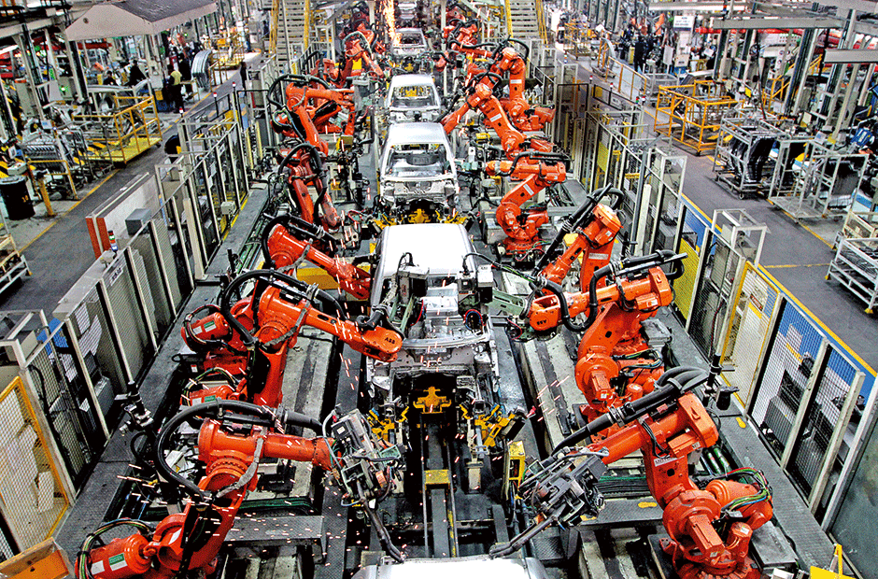
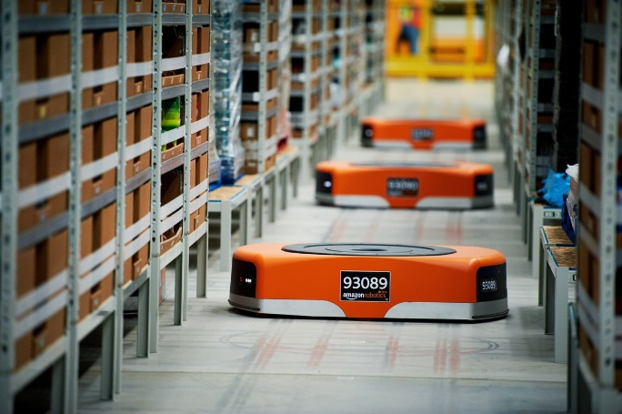
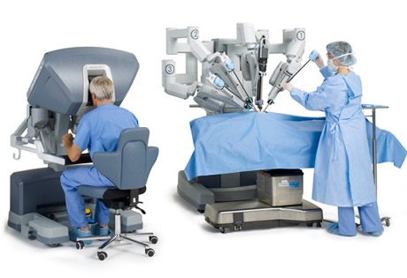
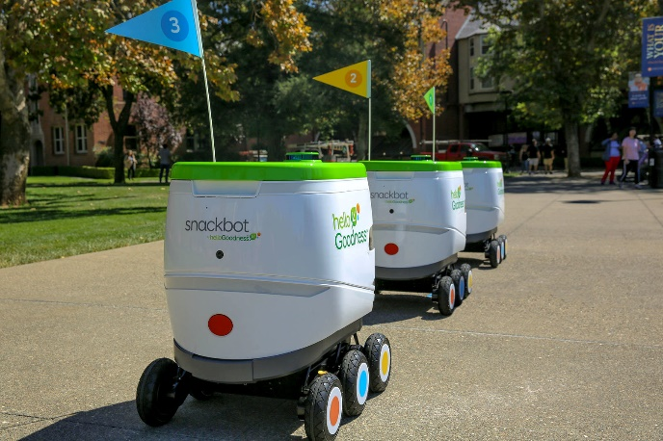
Robots are changing our life!

Slide 3

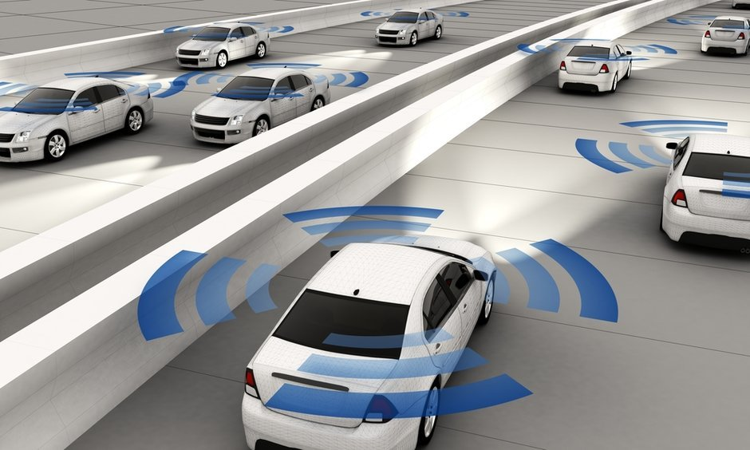
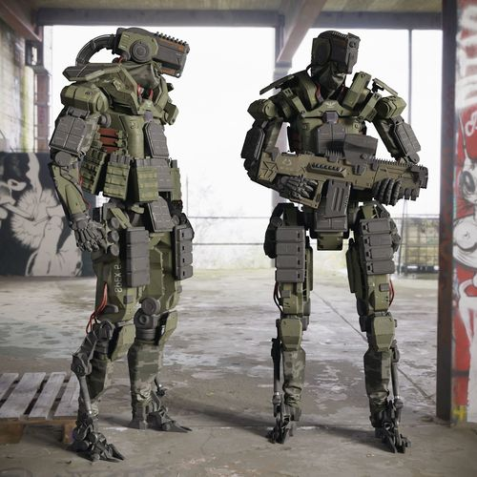
They will do it more in the future!

Slide 4
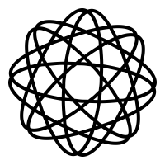


Challenges
I want to program my robot from scratch!
Complex
Inefficient
Time consuming

Slide 5

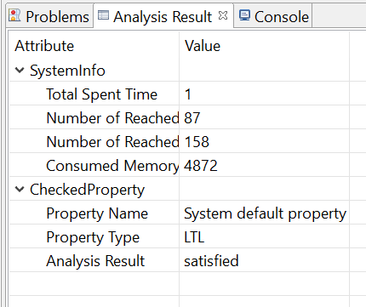
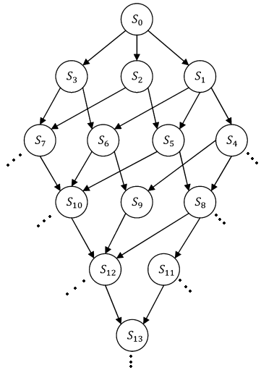

RoboRebeca Framework
Timed Rebeca model
ROS program
Model checking
Correct
Modification
Incorrect
Manual inspection
State space
(Timed Transition System)

Slide 6

Robot Operating System (ROS)
A set of software libraries and tools that help you build robot applications

Slide 7
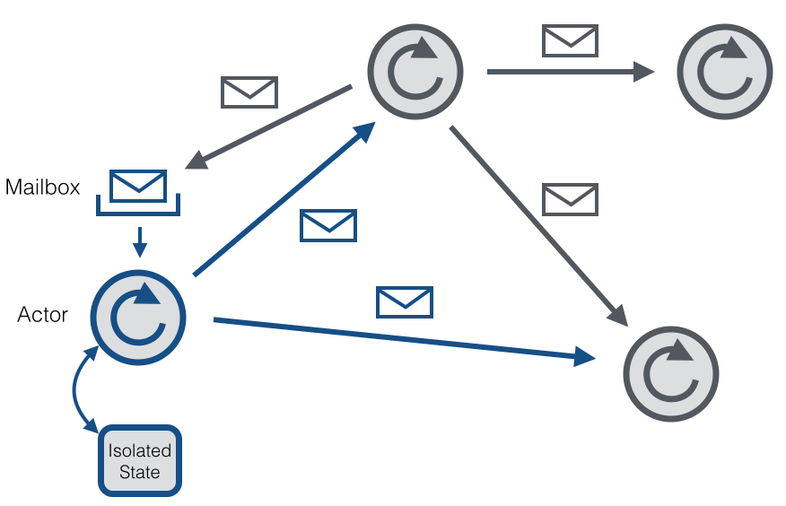
Rebeca: The Modeling Language
Rebeca: Reactive object language
Based on Hewitt actors
Concurrent reactive objects (OO)
Java-like syntax
Communication:
Asynchronous message passing
No explicit receive
Computation:
Take a message from top of the queue and execute it
Event-driven
Timed Rebeca (TRebeca):
An extension of Rebeca with timing primitives

Slide 8
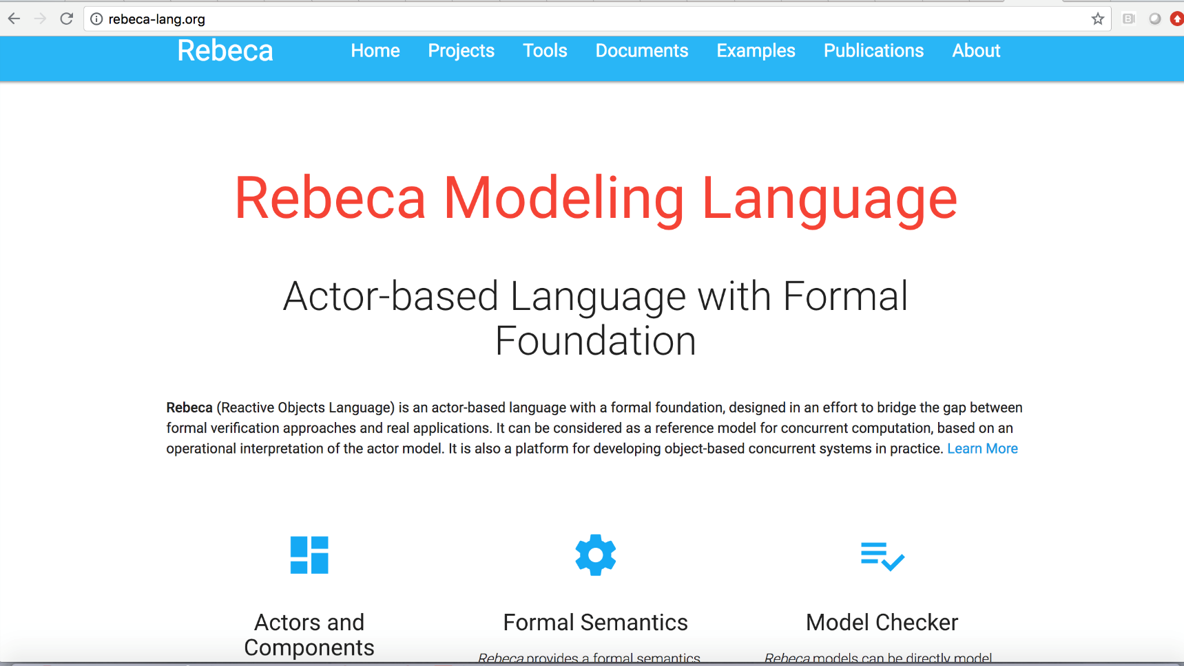
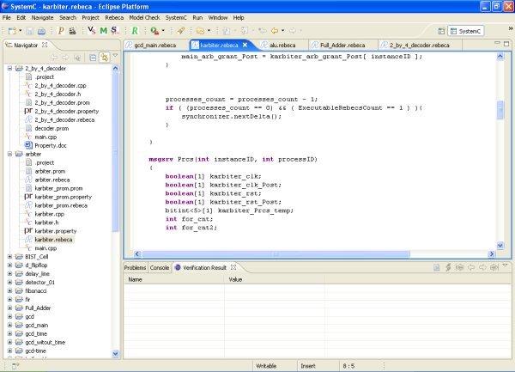

Rebeca: Tool Support
Project editor
Model and Property editor
Model checking result view
http://www.rebeca-lang.org/

Slide 9
Rebeca Model in RoboRebeca

Slide 10
Rebeca Model in RoboRebeca (Cont’d)

Slide 11
Rebeca Model in RoboRebeca (Cont’d)

Slide 12
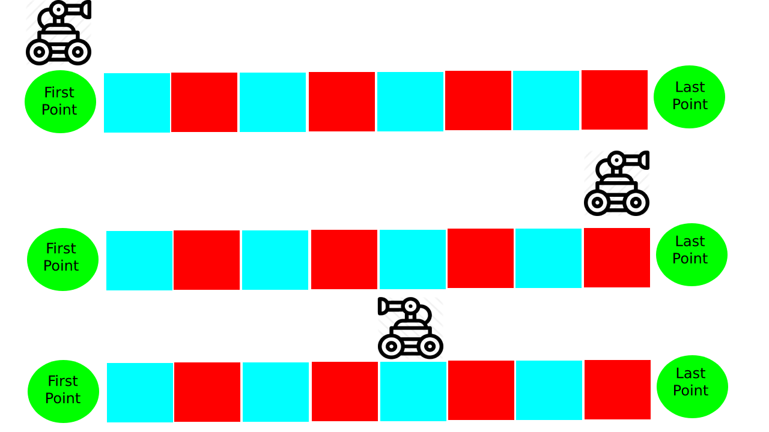
Movement Scenario

Slide 13
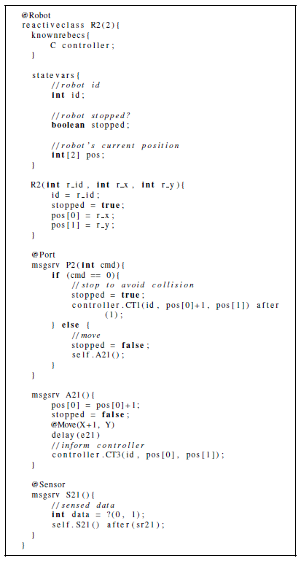
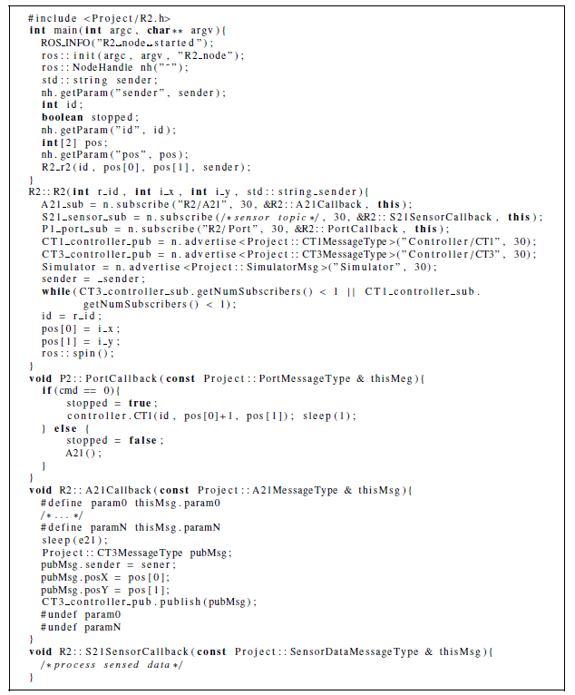
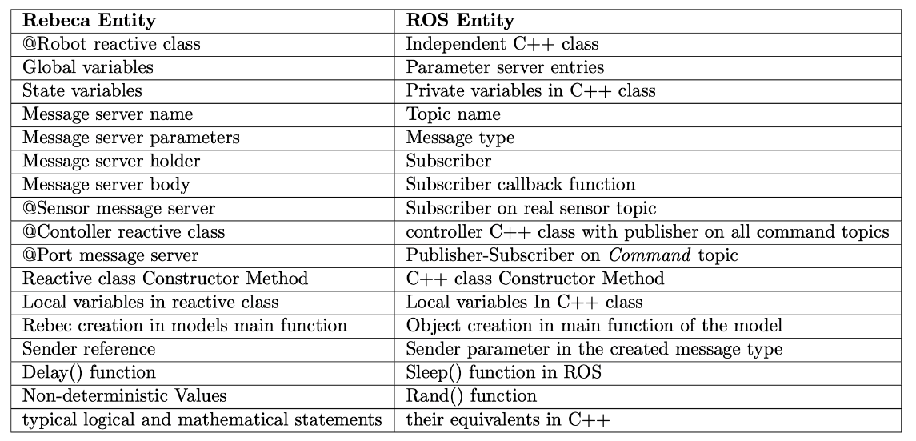
Code Synthesis in RoboRebeca
TRebeca Model
ROS Program
Mapping Rules

Slide 14
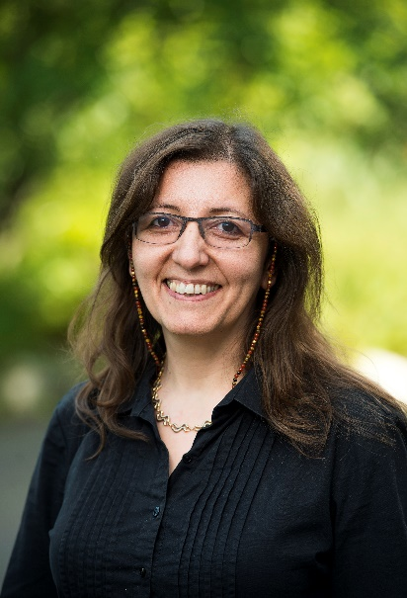

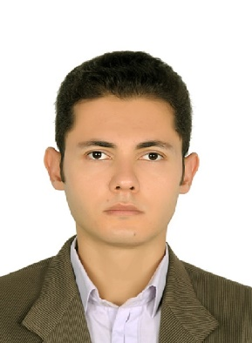
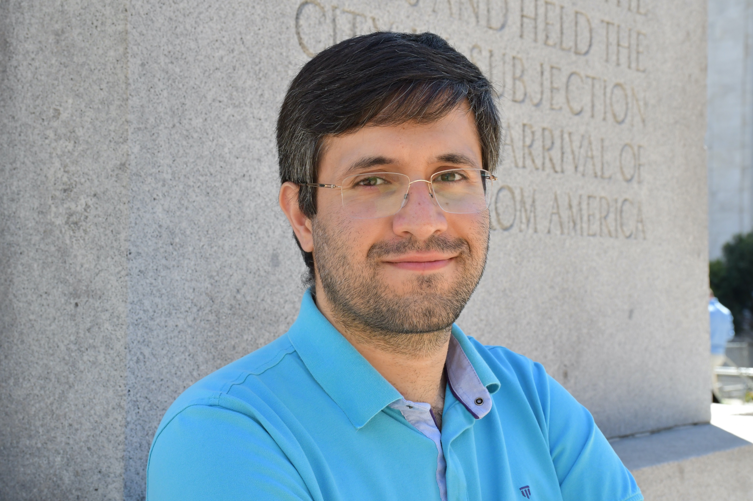
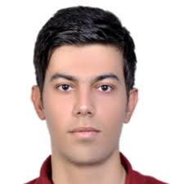
Project Team
Torbjörn Martinsson
Volvo CE
Bahar Salmani
SU
Marjan Sirjani
MDH
Ali Sedaghatbaf
MDH
Saeid Dehnavi
MDH
Ehsan Khamespanah
RU
Jonn Lantz
Volvo Cars

Slide 15

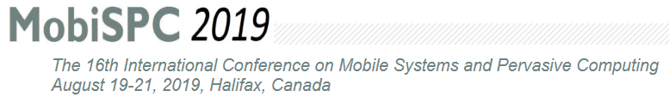
Publication
Towards an Actor-based Approach to Design Verified ROS-based Robotic Programs using Rebeca
Authors: Saeid Dehnavi, Ali Sedaghatbaf, Bahar Salmani, Marjan Sirjani, Mehdi Kargahi, Ehsan Khamespanah

Slide 16




Sponsors
This work is financed by:

